Slide 1
Conversion of the Band Diagram Program
A Look at Portability, Efficiency and Ease of Use.
Michael Baker

Slide 2
MOS Devices
MOS stands for Metal – Oxide – Semiconductor
Very common structure used in:
Diodes
Transistors
Light Emitting Diodes (LEDs)
Solar Cells
These components, specifically diodes and transistors, are used in almost all electronic devices today.

Slide 3
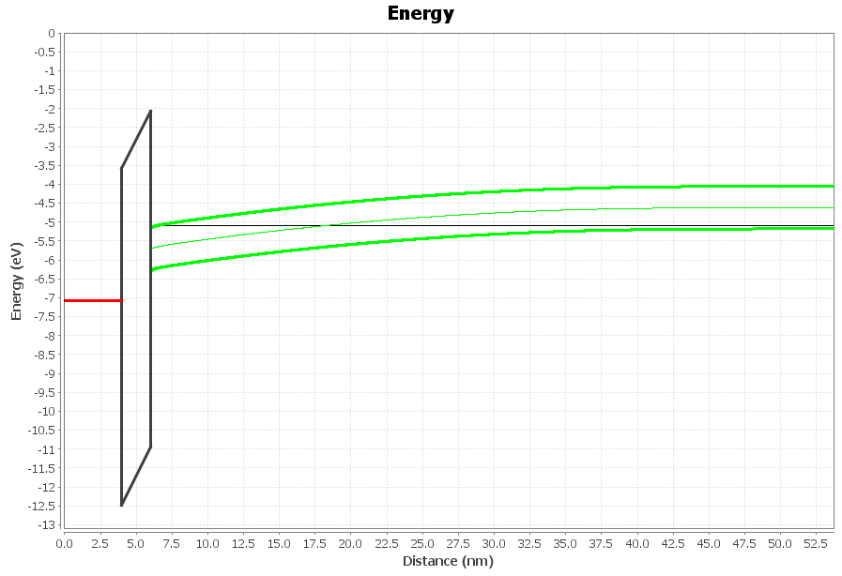
What is a Band Diagram?
Shows the energy distribution in a semiconductor.
As temperature and voltage applied change, the diagram can display how those changes affect the MOS device.
Band diagrams can require a lot of time to create by hand, especially when the MOS structure is complex.

Slide 4
Why do we need Band Diagrams?
Band Diagrams help to see how materials react to being used together in a device.
They help to find more efficient or special purpose MOS device configurations.
When created for a range of voltages, they can tell us how the device will perform under stress before it is built.

Slide 5
Band Program History
Created by Richard Southwick III under the direction of William Knowlton
Version 1 (created in 2005) supported:
MOS devices with up to 2 oxides
Image Output (WMF format)
Data Export (CSV format)
This version was written in C++.

Slide 6
Band Program History (continued…)
Program reworked in version 2 (around 2007) to support:
Any number of oxides and metals.
Inserting fixed charges into oxides.
Ability to define some values as a function of temperature.
Ability to add, edit and remove materials
This version was written in C#.

Slide 7
Why Convert?
Users needed the software to work on Linux and Mac OS systems.
Compiling with the Mono project would cause crashes in these operating systems.
Progress on the Mono project was slow and always naturally behind .NET.
A solution was needed that would work well on Windows, Linux and Mac OS in preferably one codebase.

Slide 8
Programming Language Selection
C/C++ was rejected because of recompiling and cross compatibility issues.
Server side and scripting languages were rejected because of poor performance and installation issues.
Java was chosen for:
Strong multi-platform compatibility
Good multi-platform 3rd party libraries.
Good speed compared to other languages.

Slide 9
Automated Translation
Java and C# are very similar in syntax.
Very different frameworks that change rapidly.
Many products currently available are expensive or incomplete.
Would have missed out on learning and optimization opportunities.

Slide 10
Tool Selection
Netbeans IDE
Free
Built-in support for Matisse Swing GUI Builder.
Built-in support for java bean binding.
Support for generating Web Start installer included.
Integrated Subversion support.
Integrated Javadoc support.

Slide 11
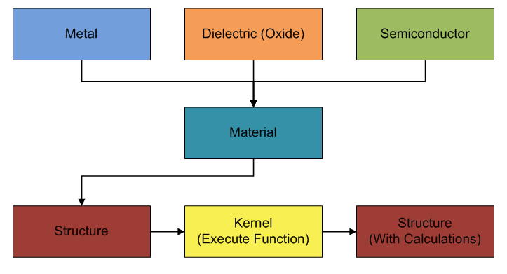
Basic Structure

Slide 12
Java and C# Comparison Similarities
Object centered.
Garbage collection.
Use intermediate compiled language and runtime for execution.
Java compiler produces byte code and runs in the Java Virtual Machine
C# compiles into the Intermediate Language and runs in the Common Language Runtime
Support Just-In-Time compilation for speed improvements.
Allow interfaces but not multiple inheritance.
Throwing and catching exceptions
Have method to bind data to GUI controls.

Slide 13
Java and C# Comparison Differences
C# has pointers, Java does not.
Java allows anonymous inner classes, C# does not.
Java supports both checked and unchecked exceptions, C# does not.
C# allows multiple classes in one file, Java does not.
C# uses properties while Java uses getter/setter functions.

Slide 14
Java Bean Binding
Allows attaching an object to controls in a form.
When controls are updated by the user they call the appropriate setter function.
Controls can automatically update when the objects are changed outside the control by calling the getter function.
Allows the forms to work on objects instead of individual fields.

Slide 15
Java Bean Binding (continued...)
Benefits
More intuitive direct relationship between object and create/edit form.
Manually refreshing views is not needed.
Makes multiple views using the same objects easy.
Difficulties
Errors during development are not always intuitive.
Getter/setter names
Objects in objects.

Slide 16
GUI Standardization
Esc to cancel, Enter to accept.
Double-click list items to edit.
Delete button to remove a list item.
User-based material files.

Slide 17
JFreeCharts
Many chart types
Panning and Zooming
True Hover Tips
Drilldown
Large user base. (Help and Bug support)
Event driven (Animation)

Slide 18
JFreeChart Animation
Charting system was not designed for live updates.
Chart redrawing is inefficient.
A user has written a patch to improve chart redraw times. Still being reviewed by the main author.

Slide 19
Object Serialization
Benefits
Easy to implement
Smaller files than text formats like XML.
Quickly load and use data, no parsing required.
Difficulties
Backward compatibility is difficult to support.
Not compatible across programming languages.
Cannot manually edit/view the data.

Slide 20
Installation and Upgrade Improvements
C# Band program uses InstallShield installer and has manually coded update support.
Java version uses Web Start for installation and updates.
Allows the user to click a link and install from the web.
Creates desktop icons and uninstall information like a native installer.
One installer will run on multiple operating systems.
Can be used offline, but will optionally update main program or support libraries if found while online.

Slide 21
Future Directions
Main focus for this project was to reproduce the existing program in Java.
Potential Future Features:
Drag and Drop Materials.
XML Materials files and Output files.
Save animation to movie format.
Multi-chart views.
Additional chart types.
Optimization scanner.
Applet Version.
Improved Threading and possible CUDA support.

Slide 22
Questions?

